Slide 1
Heat Treatments of Metals
Oiram Colunga Bernal
1818785
IMTC

Slide 2
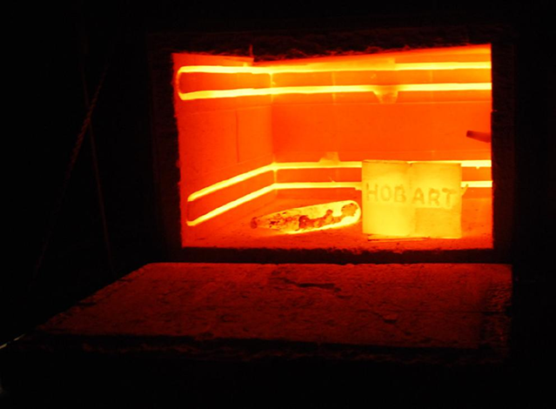
What does it consist of?
They are a series of controlled heating and cooling operations used to bring about a desired change in the physical properties of a metal. Its purpose is to improve the structural and physical properties for some particular use or for future work of the metal.

Slide 3
The 3 basic steps of all heat-treating processes:
There are five basic heat treating processes and all of them involve three basic steps: heating, soaking, and cooling.

Slide 4
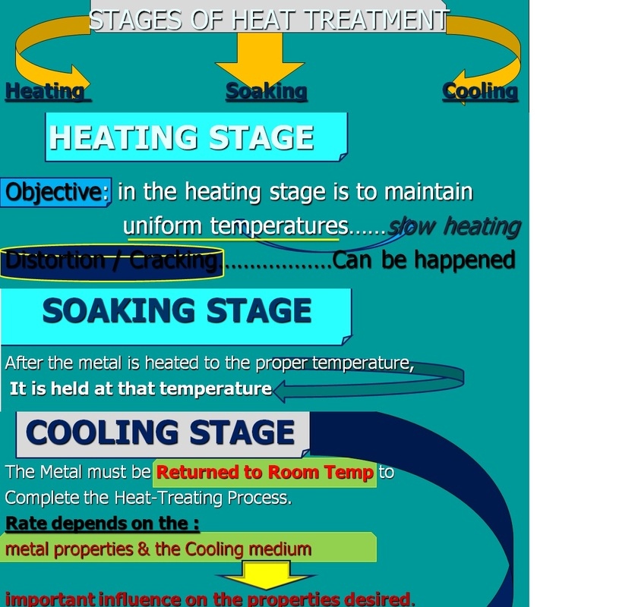

Slide 5
HEATING
Heating is the first step in a heat-treating process. Many alloys change structure when they are heated to specific temperatures. The structure of an alloy at room temperature can be either a mechanical mixture, a solid solution, or a combination solid solution and mechanical mixture.

Slide 6
SOAKING
Once a metal part has been heated to the temperature at which desired changes in its structure will take place, it must remain at that temperature until the entire part has been evenly heated throughout. This is known as soaking. The more mass the part has, the longer it must be soaked.

Slide 7
Cooling
After the part has been properly soaked, the third step is to cool it. Here again, the structure may change from one chemical composition to another, it may stay the same, or it may revert to its original form.

Slide 8
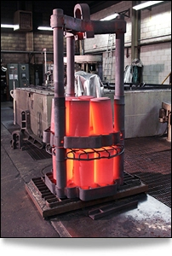
Case hardening with subsequent hardening operation:
Case hardening is the process of hardening the surface of a metal by infusing elements into the material’s surface, forming a thin layer of harder alloy.
Combined with a subsequent hardening operation the desired component properties can be varied to suit the application.

Slide 9
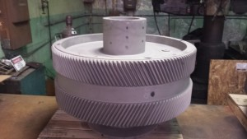
Case hardening without subsequent hardening operation:
Case hardening without subsequent hardening operation, also often generically referred to as nitriding, is the diffusion of nitrogen into the surface of special alloy steel to give a hard surface and soft core without the need for further treatment.

Slide 10
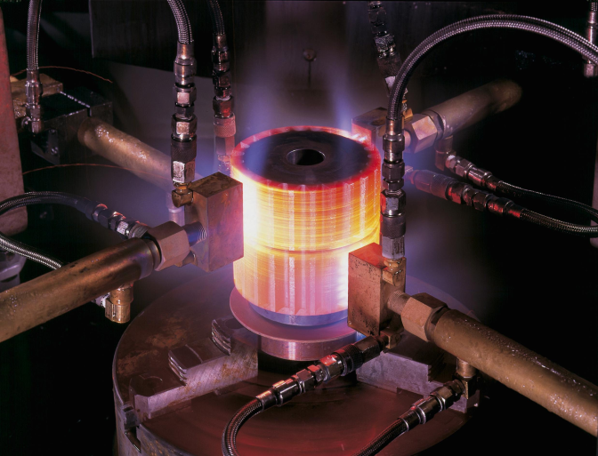
Hardening
Metal hardening processes are used to impart specific mechanical properties to a component in order to render it fit for use. A metal is normally hardened by heating the metal to the required temperature and then cooling it rapidly by plunging the hot metal into oil, water, or brine. Most steels must be cooled rapidly to harden them. The hardening process increases the hardness and strength of metal, but also increases its brittleness.

Slide 11
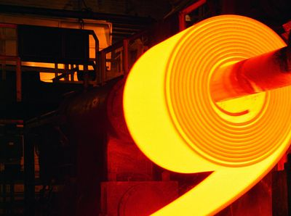
Tempering
Steel is usually harder than necessary and too brittle for practical use after being hardened. Severe internal stresses are set up during the rapid cooling of the metal. Steel is tempered after being hardened to relive the internal stresses and reduce its brittleness. Tempering consists of heating the metal to a specified temperature and then permitting the metal to cool. The rate of cooling usually has no effect on the metal structure during tempering. Therefore, the metal is usually permitted to cool in still air. Temperatures used for tempering are normally much lower than the hardening temperatures. The higher the tempering temperature used, the softer the metal becomes. High-speed steel is
one of the few metals that becomes harder
instead of softer after it is tempered.

Slide 12
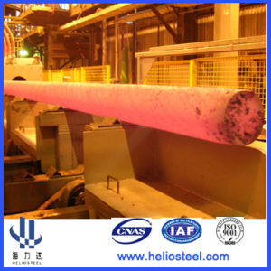
Annealing
Metals are annealed to relieve internal stresses, soften them, make them more ductile, and refine their grain structures. Metal is annealed by heating it to a prescribed temperature, holding it at that temperature for the required time, and then cooling it back to room temperature. The rate at which metal is cooled from the annealing temperature varies greatly. Steel must be cooled very slowly to produce maximum softness.

Slide 13
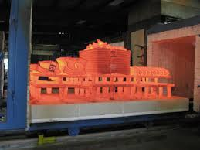
Normalizing
Metals are normalized to relieve the internal stresses produced by machining, forging, or welding. Normalized steels are harder and stronger than annealed steels. Parts that will be subjected to impact and parts that require maximum toughness and resistance to external stresses are usually normalized. Low carbon steels do not usually require normalizing, but no harmful effects result if these steels are normalized. Normalizing is achieved by heating the metal to a specified temperature (which is higher than either the hardening or annealing temperatures), soaking the metal until it is uniformly heated, and cooling it in still air.

Slide 14
Bibliography
http://www.bodycote.com/en/services/heat-treatment/case-hardening-with-subsequent-hardening-operation.aspx
http://www.bodycote.com/en/services/heat-treatment/case-hardening-without-subsequent-hardening-operation.aspx
http://www.bodycote.com/en/services/heat-treatment/harden-and-temper.aspx
http://www.bodycote.com/en/services/heat-treatment/solution-and-age.aspx
http://www.bodycote.com/en/services/heat-treatment/annealing-normalising/normalising.aspx
http://www.bodycote.com/en/services/heat-treatment/annealing-normalising.aspx
http://www.americanmachinetools.com/heat_treating_metals.htm

